Slide 1
CMPE-295B Project Presentation on HobbyHorse- A Social Datamining Website
Guided by:
Prof. Eirinaki Magdalani
Presented By:
Radhika Wadegaonkar
Sulagna Bal
Notes:
This template can be used as a starter file for presenting training materials in a group setting.
Sections
Right-click on a slide to add sections. Sections can help to organize your slides or facilitate collaboration between multiple authors.
Notes
Use the Notes section for delivery notes or to provide additional details for the audience. View these notes in Presentation View during your presentation.
Keep in mind the font size (important for accessibility, visibility, videotaping, and online production)
Coordinated colors
Pay particular attention to the graphs, charts, and text boxes.
Consider that attendees will print in black and white or grayscale. Run a test print to make sure your colors work when printed in pure black and white and grayscale.
Graphics, tables, and graphs
Keep it simple: If possible, use consistent, non-distracting styles and colors.
Label all graphs and tables.

Slide 2
Project Objective & Goal
A social data mining website that encourages and stimulates all kinds of hobbies.
The mode would be online and through video calling session
Not only can one pursue hobby, he/she can socialize with people of same interest.
Notes:
Give a brief overview of the presentation. Describe the major focus of the presentation and why it is important.
Introduce each of the major topics.
To provide a road map for the audience, you can repeat this Overview slide throughout the presentation, highlighting the particular topic you will discuss next.

Slide 3
Technologies & Environment
Client end :
HTML5 and CSS3
Javascript
Server end:
Java Spring 3 MVC
PHP
Database
MySQL
External APIs used
OpenTok for video calling
Others
Mac OS, MAMP server, Tomcat 6, Maven
Notes:
Give a brief overview of the presentation. Describe the major focus of the presentation and why it is important.
Introduce each of the major topics.
To provide a road map for the audience, you can repeat this Overview slide throughout the presentation, highlighting the particular topic you will discuss next.

Slide 4
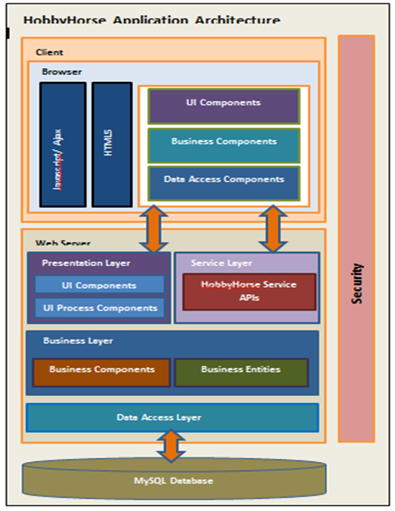
System Architecture

Slide 5
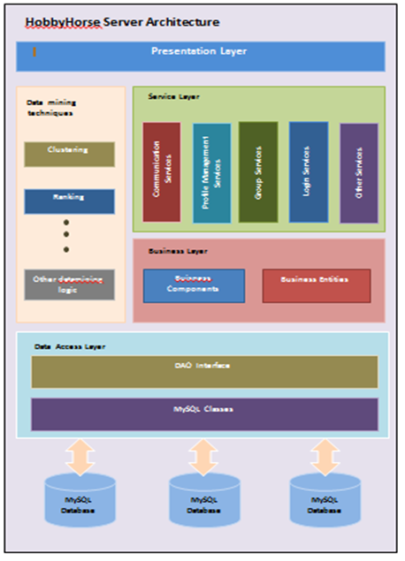
Server Architecture

Slide 6
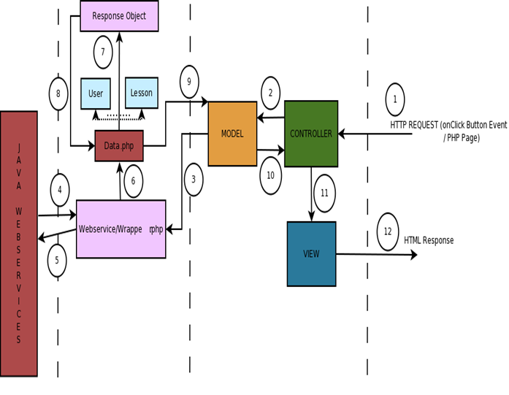
Middle-Tier Details

Slide 7
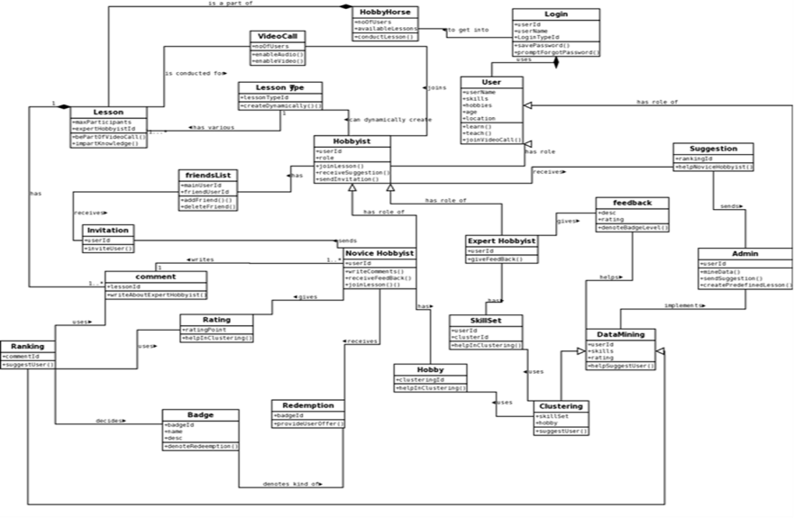
System Class Diagram

Slide 8
Major Application Features
Sign in with HobbyHorse or use Facebook login.
Create new lesson or choose from existing.
Join/Start lesson.
Leave Feedback/Comments on a lesson.
Rank expert hobbyist based on his comments.
Provide badges to novice users.
Others..
Notes:
Give a brief overview of the presentation. Describe the major focus of the presentation and why it is important.
Introduce each of the major topics.
To provide a road map for the audience, you can repeat this Overview slide throughout the presentation, highlighting the particular topic you will discuss next.

Slide 9
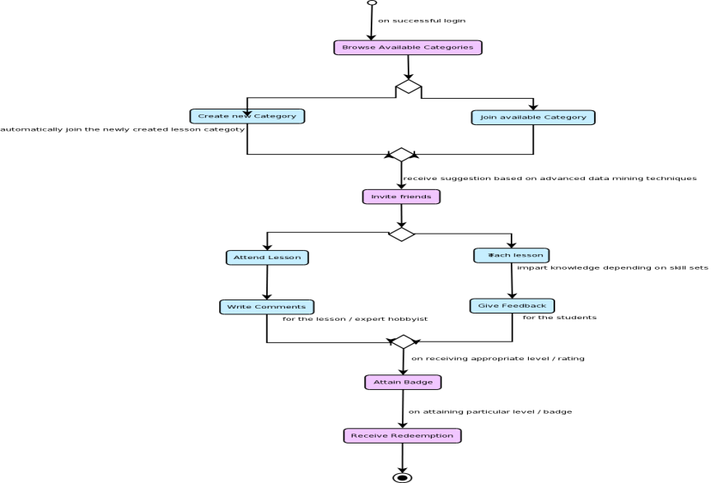
Application Flow

Slide 10
Datamining Techniques & Algos
Apriori Algo and Association Rule for lesson recommendation to general users.
Ranking expert users based on his received comments.
Deciding badge-levels for novice users based on the number of lessons attended.
Other..
Notes:
Give a brief overview of the presentation. Describe the major focus of the presentation and why it is important.
Introduce each of the major topics.
To provide a road map for the audience, you can repeat this Overview slide throughout the presentation, highlighting the particular topic you will discuss next.

Slide 11
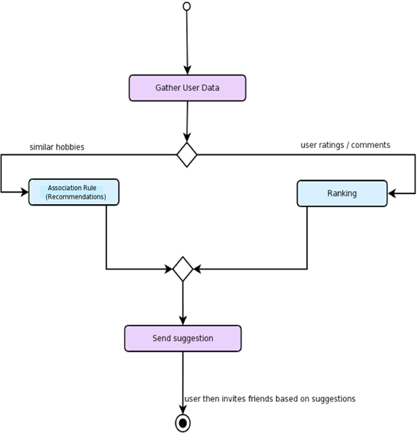
Datamining Techniques &Algos cntd..
Notes:
Give a brief overview of the presentation. Describe the major focus of the presentation and why it is important.
Introduce each of the major topics.
To provide a road map for the audience, you can repeat this Overview slide throughout the presentation, highlighting the particular topic you will discuss next.

Slide 12
Challenges Faced
Notes:
Give a brief overview of the presentation. Describe the major focus of the presentation and why it is important.
Introduce each of the major topics.
To provide a road map for the audience, you can repeat this Overview slide throughout the presentation, highlighting the particular topic you will discuss next.

Slide 13
Future Enhancements
Migrate to NoSQL database.
Incorporate users various social data accounts like Facebook, LinkedIn.
Invite HobbyHorse users’ Facebook friends.
APIs or sponsors to reimburse users points .
Other data mining techniques for filtering and clustering.
Notes:
Give a brief overview of the presentation. Describe the major focus of the presentation and why it is important.
Introduce each of the major topics.
To provide a road map for the audience, you can repeat this Overview slide throughout the presentation, highlighting the particular topic you will discuss next.

Slide 14

Screen Shots

Slide 15
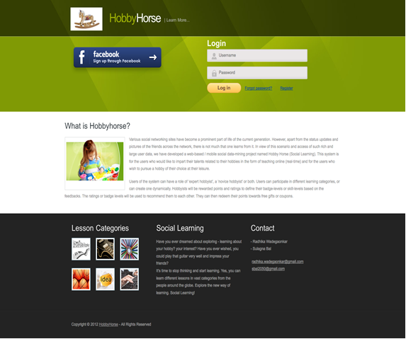
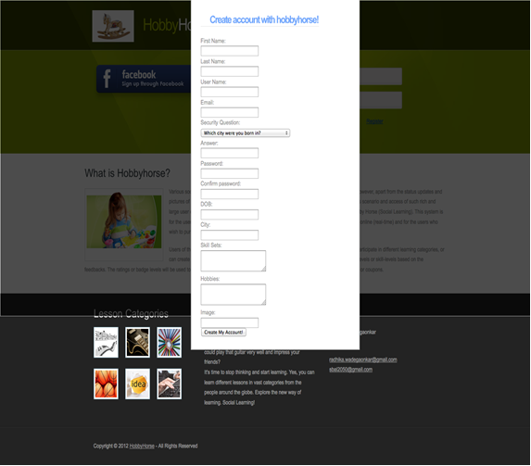
Registration Page
Login Page
Notes:
Give a brief overview of the presentation. Describe the major focus of the presentation and why it is important.
Introduce each of the major topics.
To provide a road map for the audience, you can repeat this Overview slide throughout the presentation, highlighting the particular topic you will discuss next.

Slide 16
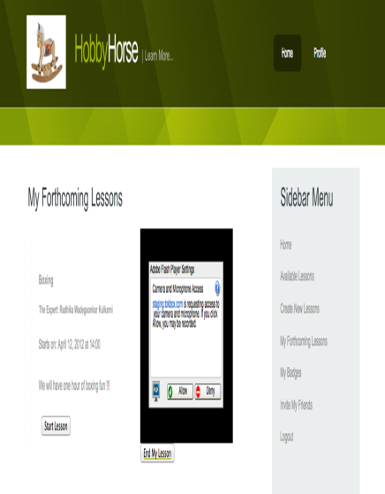
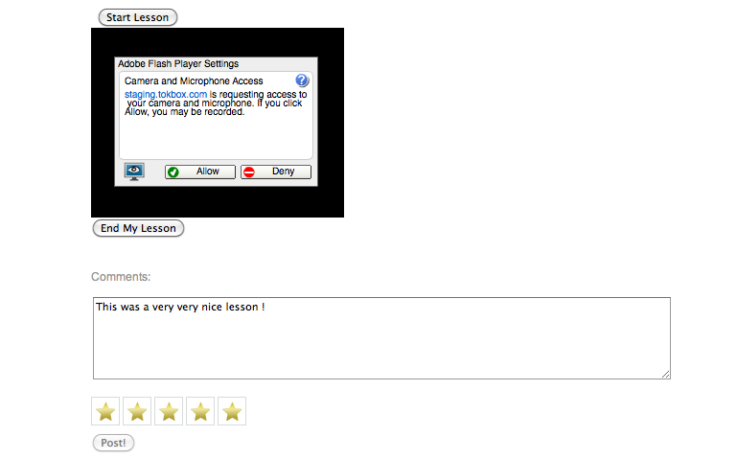
Feedback/Comments Page
Start Lesson Page
Notes:
Give a brief overview of the presentation. Describe the major focus of the presentation and why it is important.
Introduce each of the major topics.
To provide a road map for the audience, you can repeat this Overview slide throughout the presentation, highlighting the particular topic you will discuss next.

Slide 17
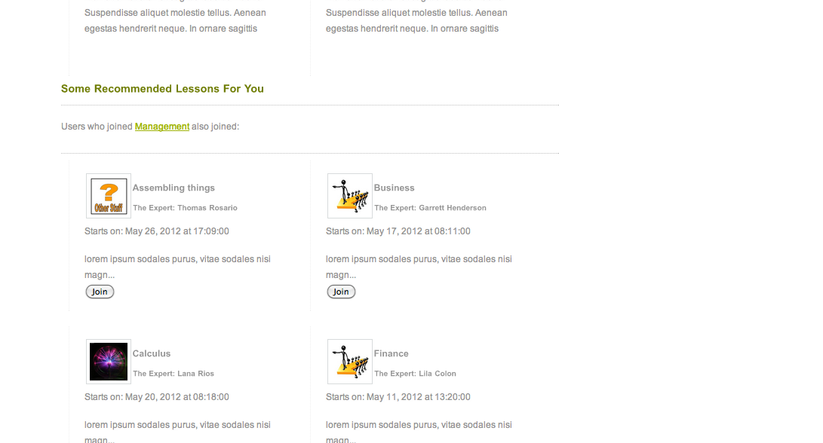
Lesson Recommendation Page
Notes:
Give a brief overview of the presentation. Describe the major focus of the presentation and why it is important.
Introduce each of the major topics.
To provide a road map for the audience, you can repeat this Overview slide throughout the presentation, highlighting the particular topic you will discuss next.

Slide 18

Thank you Prof. Eirinaki Magdalini, for being our advisor. The suggestions and guidance that you provided us throughout this journey have helped us take the project in the right direction. It had been a pleasure to work under your supervision. We thank you from the bottom of our heart.
…. THANK YOU….

Slide 19


Welcome To HobbyHorse world…

